Slide 1


HEP Weekly Report
George Bakas

Slide 2
Weekly Report
Top Tagger:
New WP’s for the 2017 and 2018 MC’s
Discovered discrepancy in the Efficiencies
This is caused from the fact that for 2018 we only have a Mtt 1000-Inf file whereas for 2016 and 2017 we have both Mtt 700-1000 and Mtt 1000-Inf files.
New efficiency, acceptance etc using only 1 file
Request for 2018 MC Mtt 700-1000
Top Angular Distributions
Worked on the MC comparisons for the 2016, 2017 and 2018
Used for all the files the same WP until we reach a WP for every year
Spin Correlation
Files are ready (CMSSW 10_2X)
Chi2Test for various distributions
DCS:
ConfDbChecks in CMSfwInstallUtils
tool that allows checks between db and project.
Managed to show the user the reference of the problem
fwInstallationUtils
Further improvements to the tool
ArdEnvino
Printed 1 box and printing 1 more
Assembly of new screens and assembly of the board so we can leave one working in the lab

Slide 3
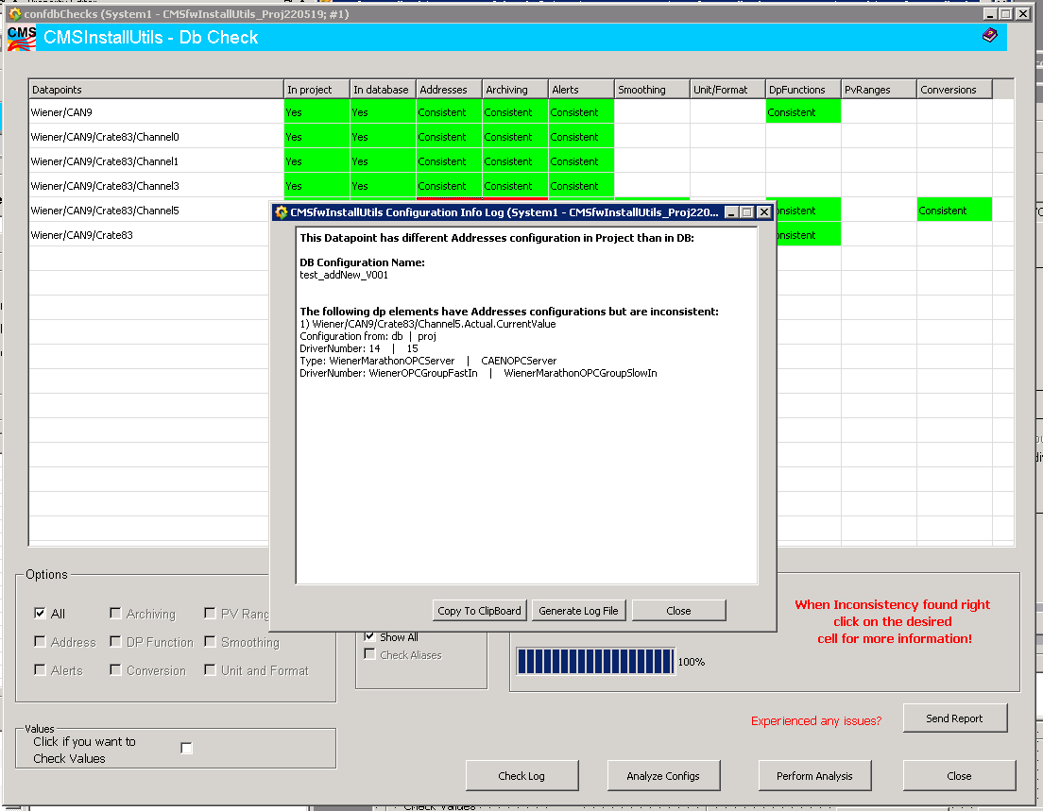
DCS

Slide 4
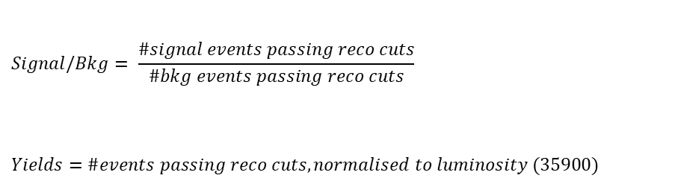
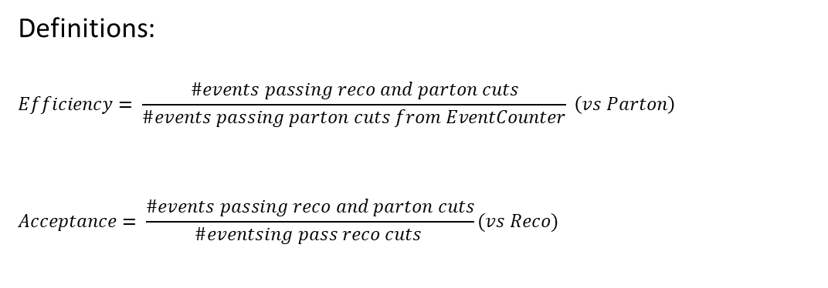
Overview
Efficiencies and Acceptance for mTT and jetPt variables
Selection:
Jet Matching
Parton cuts:
partonPt[0],[1] > 400
|partonEta[0],[1]| < 2.4
mTTbarParton > 1000
Reco cuts:
nJets > 1
nLeptons = 0
mJJ > 1000
jetPt[0],[1] > 400
|jetEta[0],[1]| < 2.4
bTagging (Medium WP deepCSV)
Tagger cut (top Tagger)
JetMassSoftDrop > 120 and < 220
Definitions:
$$Efficiency= \frac{\#events passing reco and parton cuts}{\#events passing parton cuts from EventCounter} \left(vs Parton\right)$$
$$Acceptance= \frac{\#events passing reco and parton cuts}{\#eventsing pass reco cuts }(vs Reco)$$
$$Signal/Bkg= \frac{\#signal events passing reco cuts}{\#bkg events passing reco cuts}$$
$$Yields=\#events passing reco cuts, normalised to luminosity (35900)$$

Slide 5
Purpose of this presentation
Purpose of this presentation is to find a Working Point for each MC (16, 17, 18) because the training is different for each year
Here we use only 1 file
2018 MC’s do not include a 700-1000 File so in order to check consistency of the efficiencies, acceptance etc we use only the 1000-Inf file
2016: We have already decided 0.2 as a WP
2017: The tested working points are 0.0, 0.1, 0.15, 0.18,0.2
2018: The tested working points are 0.0, 0.1, 0.15, ,0.2, 0.25
For each of these WP’s we present the efficiency and acceptance and for the WP’s that seem promising (same efficiency for the pT variable) we show the Signal/Bkg and the expected yields

Slide 6
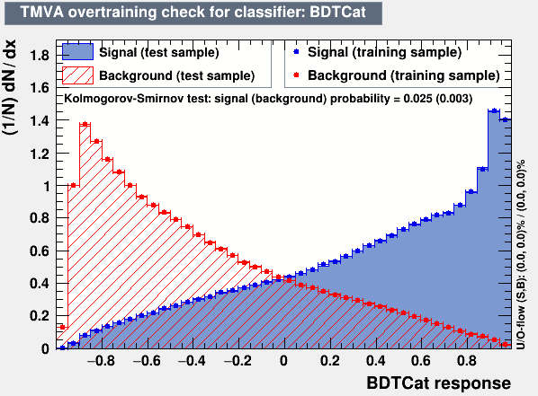
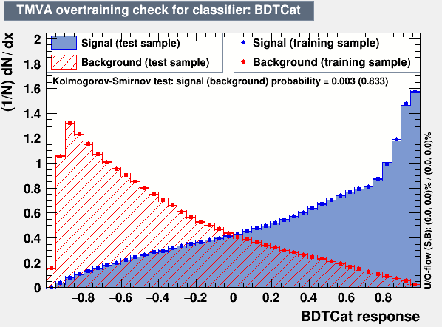
Training Outputs
2017
2018

Slide 7
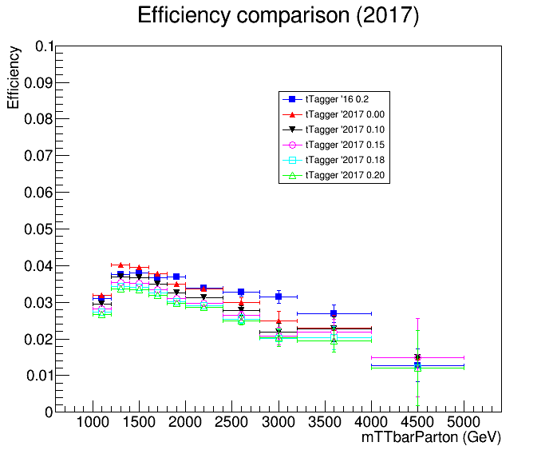
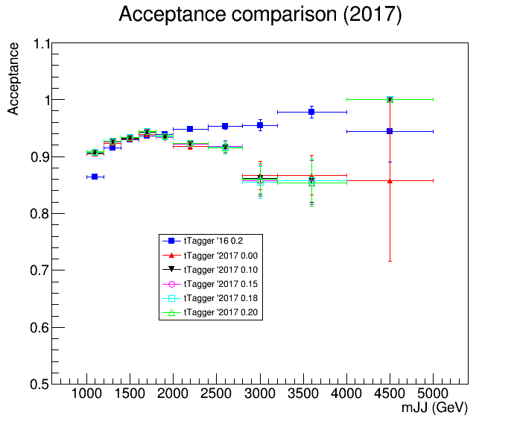
Acceptance and Efficiency 2016 vs 2017

Slide 8
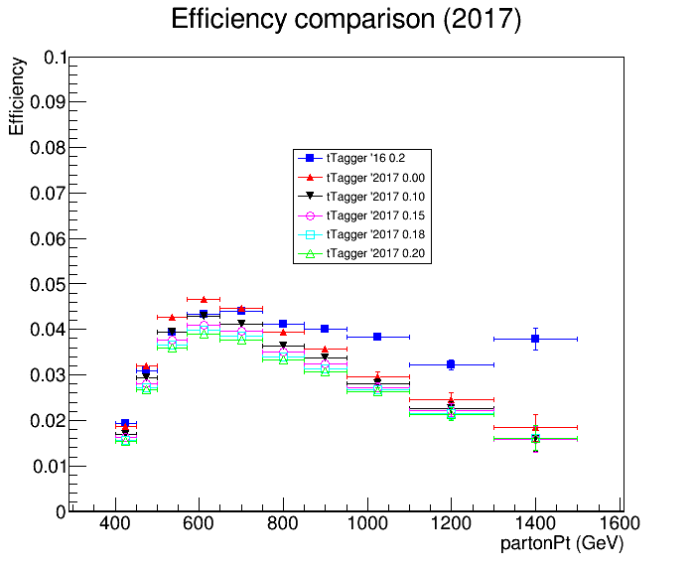
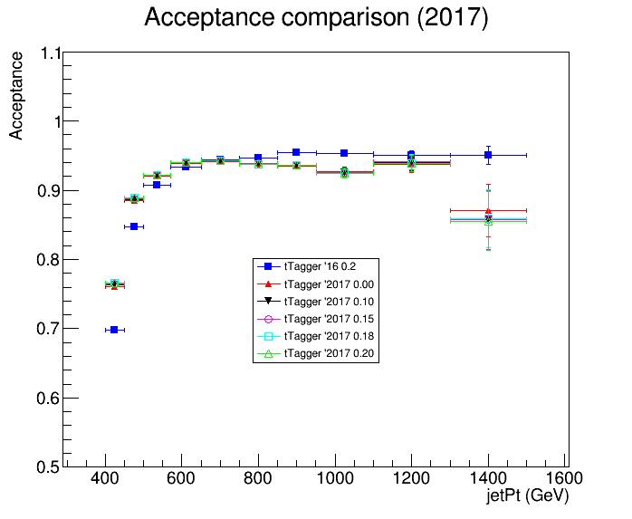
Acceptance and Efficiency 2016 vs 2017

Slide 9
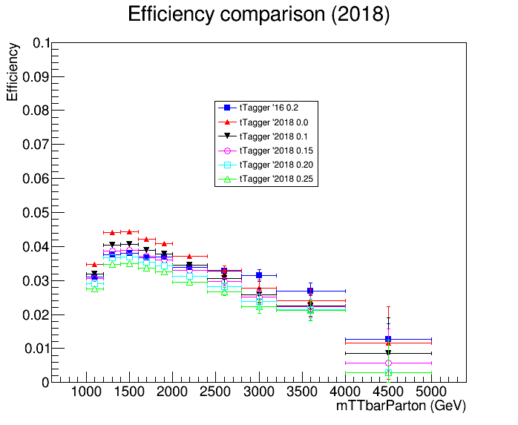
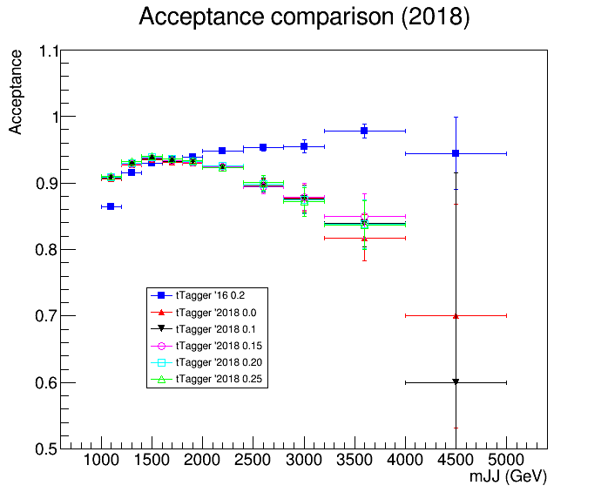
Acceptance and Efficiency 2016 vs 2018

Slide 10
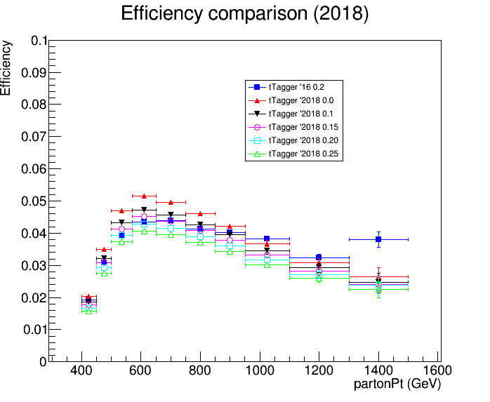
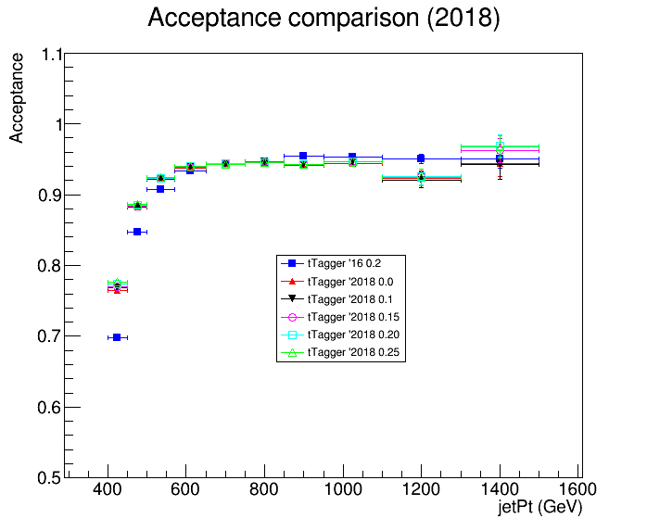
Acceptance and Efficiency 2016 vs 2018

Slide 11
Output
Most promising Working points that are compatible with the 2016 efficiency are the following:
2017: 0.0 and 0.1
2018: 0.1 and 0.15
For these WP’s we also plot the Signal/Bkg wrt the 2016 (0.2 WP)

Slide 12
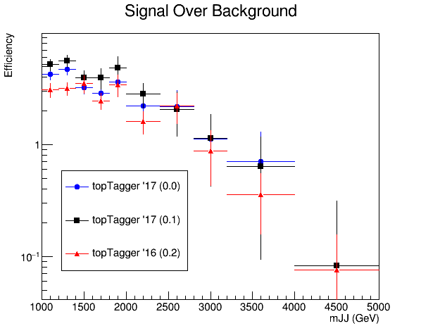
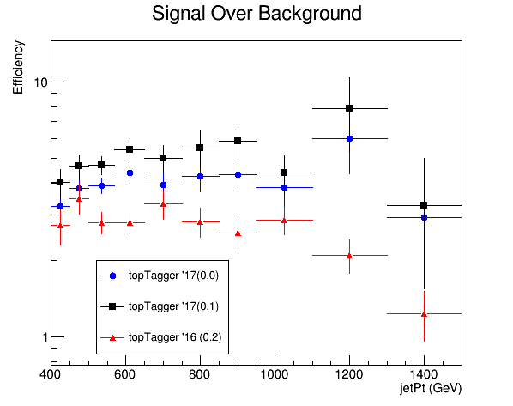
Signal over Background 2016 vs 2017

Slide 13
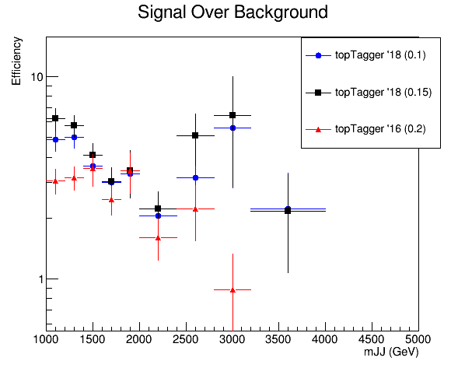
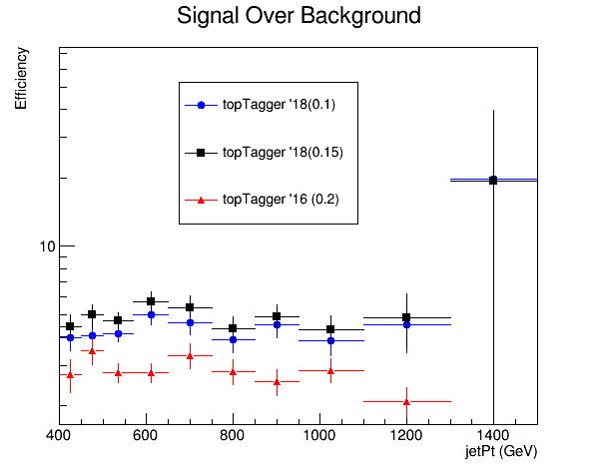
Signal over Background 2016 vs 2018

Slide 14
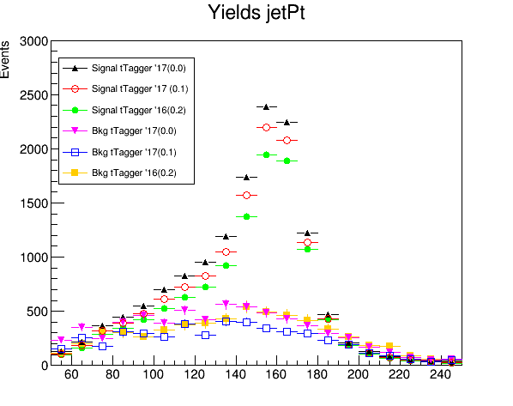
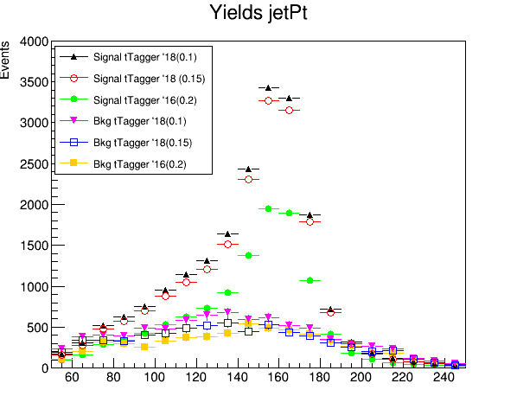
Yields 2016, 2017, 2018
jetMassSoftDrop (GeV)
jetMassSoftDrop (GeV)

Slide 15
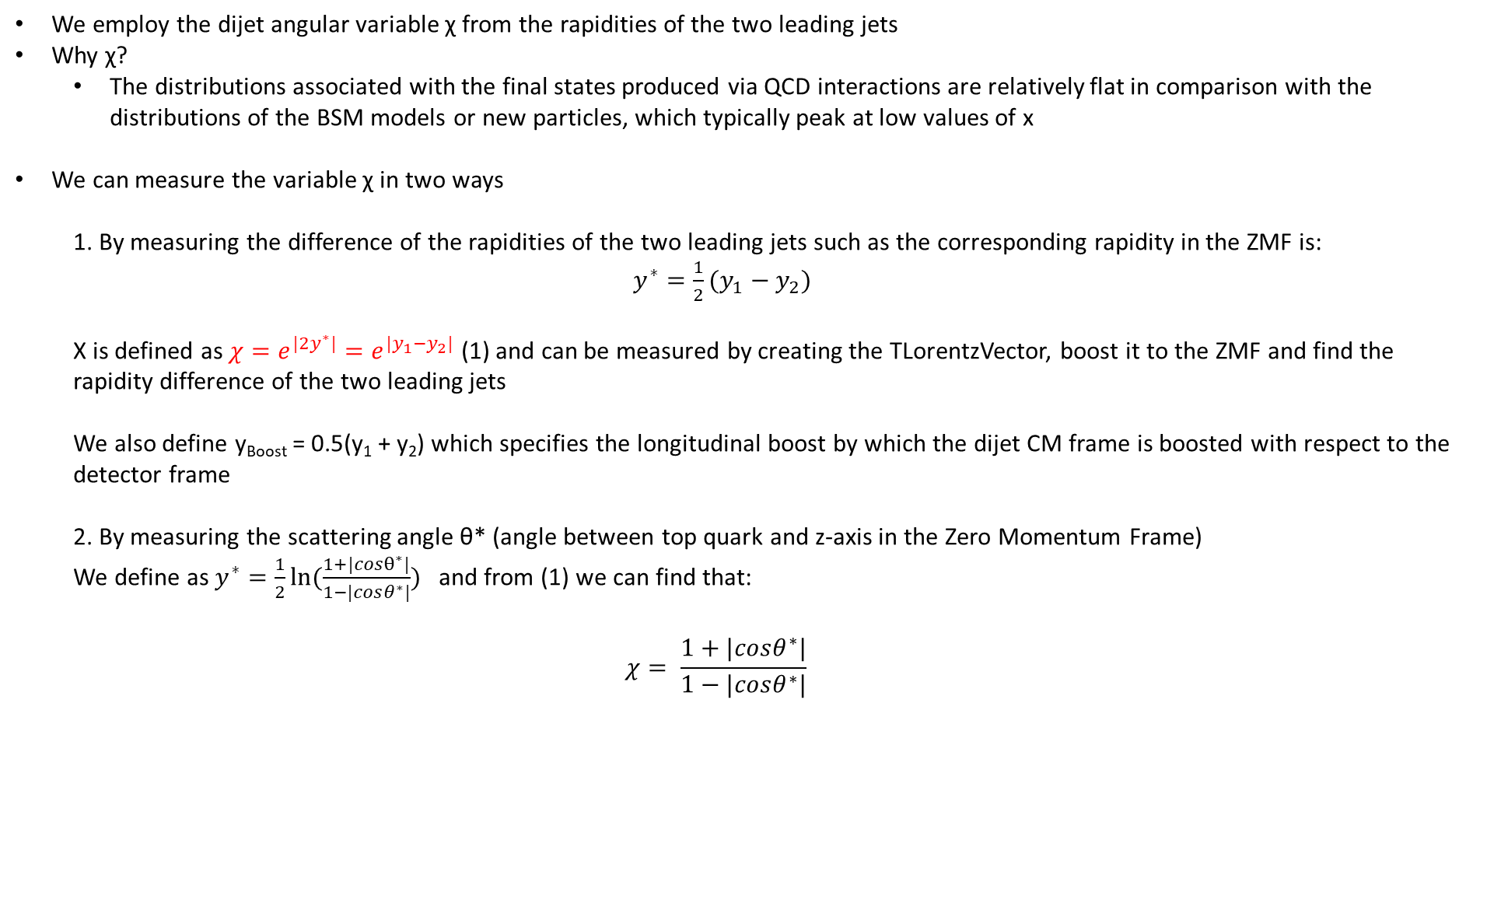
Top Angular Distributions
We employ the dijet angular variable χ from the rapidities of the two leading jets
Why χ?
The distributions associated with the final states produced via QCD interactions are relatively flat in comparison with the distributions of the BSM models or new particles, which typically peak at low values of x
We can measure the variable χ in two ways
1. By measuring the difference of the rapidities of the two leading jets such as the corresponding rapidity in the ZMF is: $y^{∗}=\frac{1}{2}(y_{1}−y_{2})$
Χ is defined as $χ=e^{{|2y}^{∗}|}=e^{|y_{1}−y_{2}|}$ (1) and can be measured by creating the TLorentzVector, boost it to the ZMF and find the rapidity difference of the two leading jets
We also define y_{Boost} = 0.5(y₁ + y₂) which specifies the longitudinal boost by which the dijet CM frame is boosted with respect to the detector frame
2. By measuring the scattering angle θ* (angle between top quark and z-axis in the Zero Momentum Frame)
We define as $y^{∗}=\frac{1}{2}ln⁡(\frac{1+|cosθ^{∗}|}{1−|cosθ^{∗}|})$ and from (1) we can find that:
$$χ= \frac{1+|cosθ^{∗}|}{1−|cosθ^{∗}|}$$

Slide 16
Response Matrices
Response matrix of χ_{reco}, χ_{parton} with {1,2,3,4,5,6,7,8,9,10,13,16} as variable binning
Response matrix of |cos(θ)|_{reco}, |cos(θ)|_{parton} 10 bins in [0,1] region
Stability, Efficiency for χ, |cos(θ)| distributions
Acceptance and purity for χ and |cos(θ)|distributions
Closure tests and TT contamination
I measure the χ using the exponential
Here you will find a comparison of 2016, 2017 and 2018 MC’s. (I only use the Mtt 1000-Inf file )

Slide 17
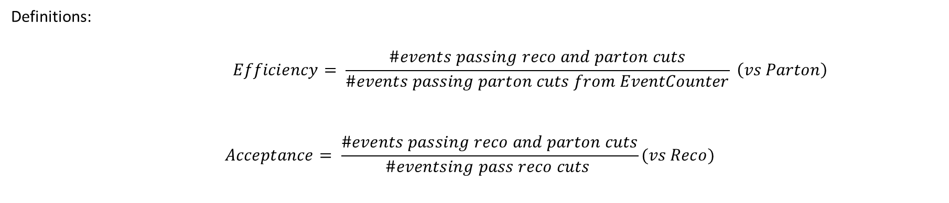
Response Matrices
Selection:
Jet Matching
Parton cuts:
partonPt[0],[1] > 400
|partonEta[0],[1]| < 2.4
mTTbarParton > 1000
Reco cuts:
nJets > 1
nLeptons = 0
mJJ > 1000
jetPt[0],[1] > 400
|jetEta[0],[1]| < 2.4
bTagging (Medium WP deepCSV)
Tagger cut(top Tagger> 0.1)
JetMassSoftDrop > 120 and < 220
Definitions:
$$Efficiency= \frac{\#events passing reco and parton cuts}{\#events passing parton cuts from EventCounter} \left(vs Parton\right)$$
$$Acceptance= \frac{\#events passing reco and parton cuts}{\#eventsing pass reco cuts }(vs Reco)$$

Slide 18
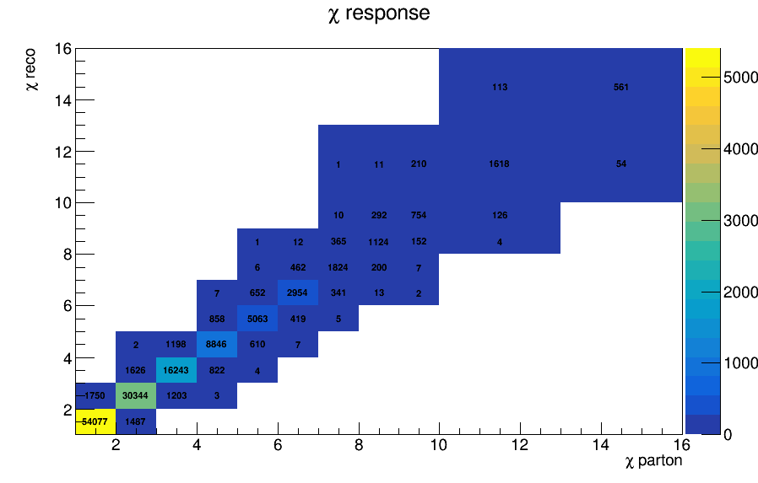
Response Matrix for χ 2016

Slide 19
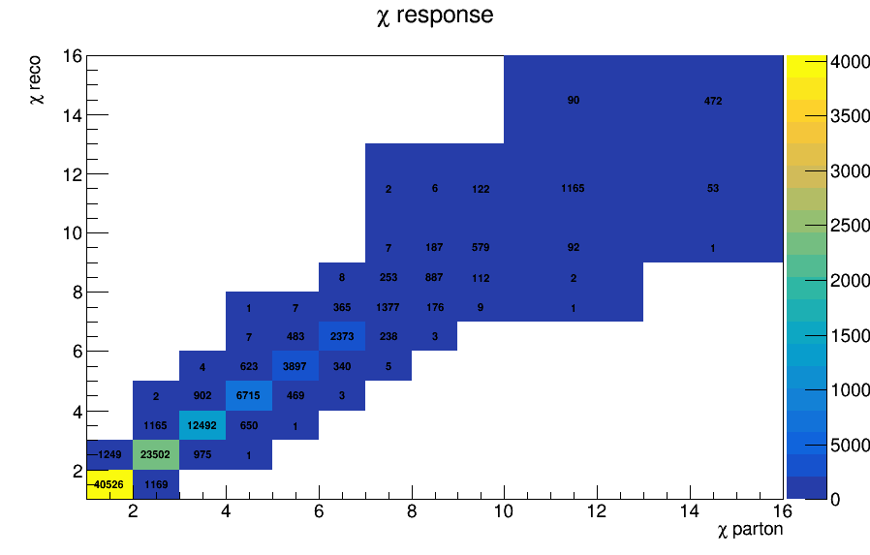
Response Matrix for χ 2017

Slide 20
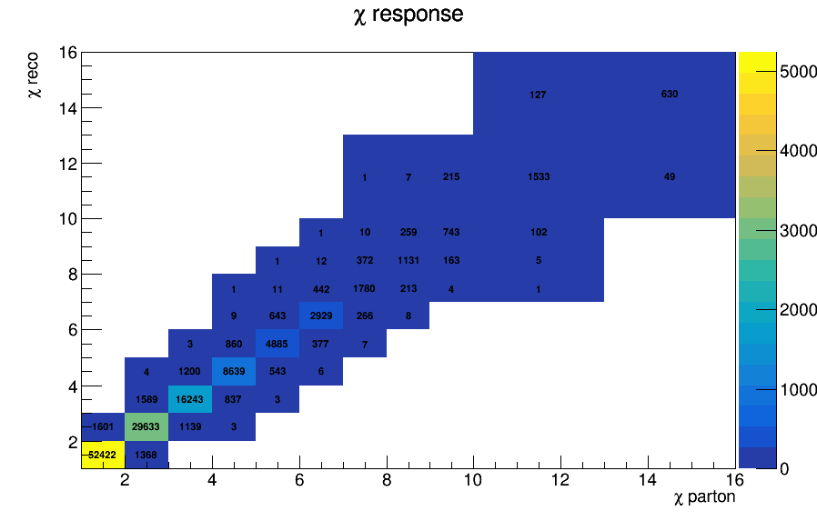
Response Matrix for χ 2018

Slide 21
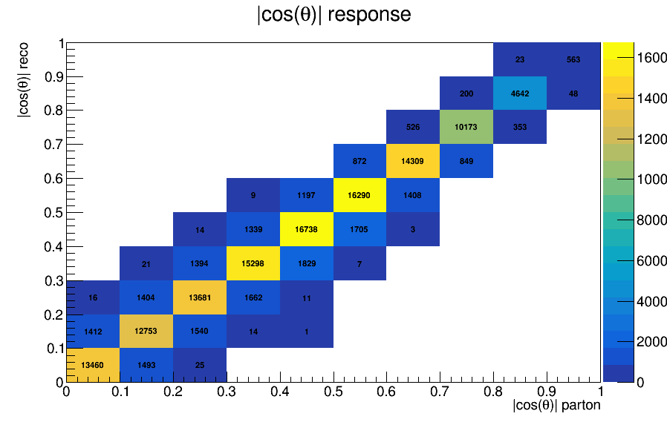
Response Matrix for |cos(θ)| 2016

Slide 22
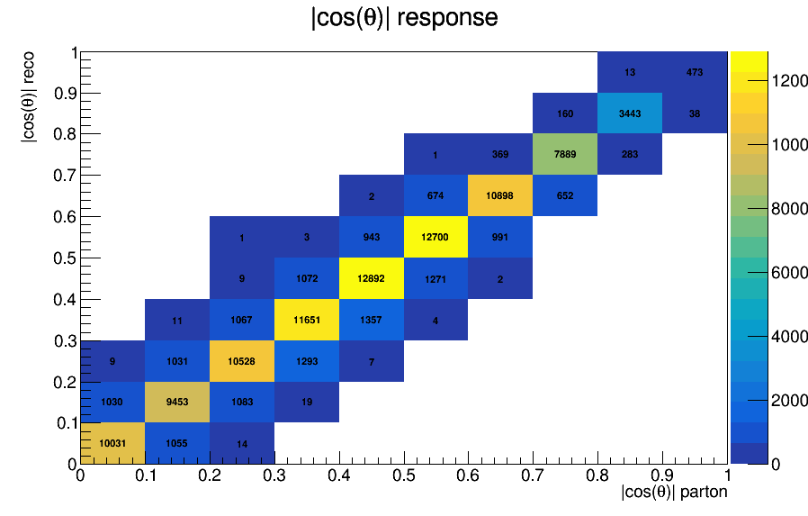
Response Matrix for |cos(θ)| 2017

Slide 23
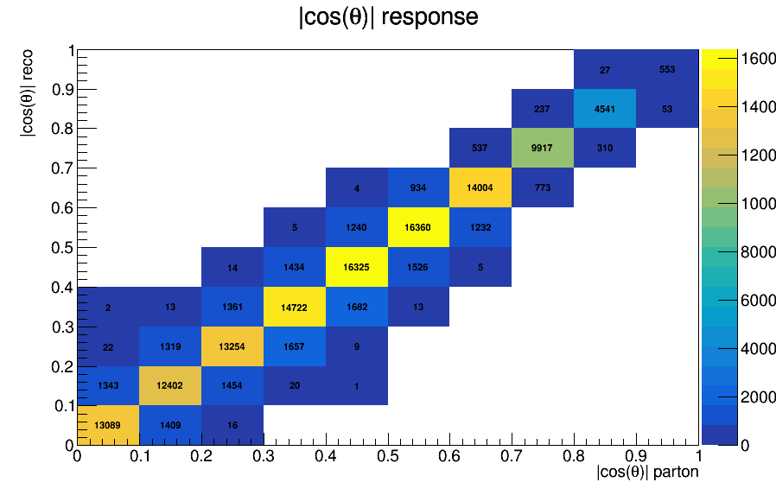
Response Matrix for |cos(θ)| 2018

Slide 24
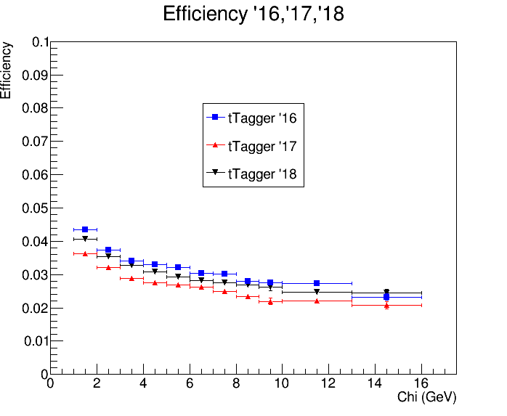
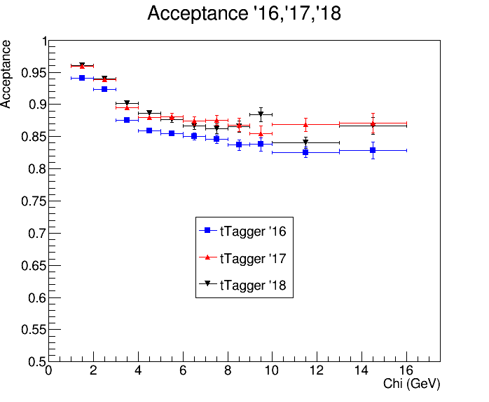
Efficiency and Acceptance for chi distribution 2016 vs 2017 vs 2018

Slide 25
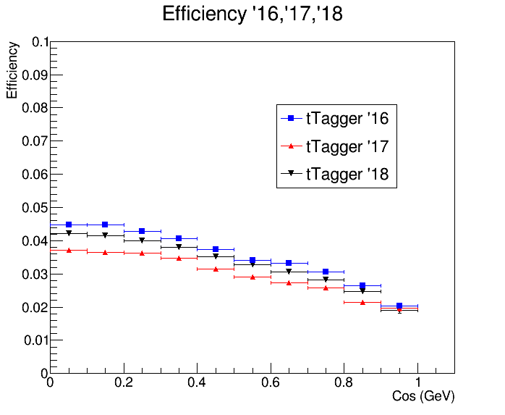
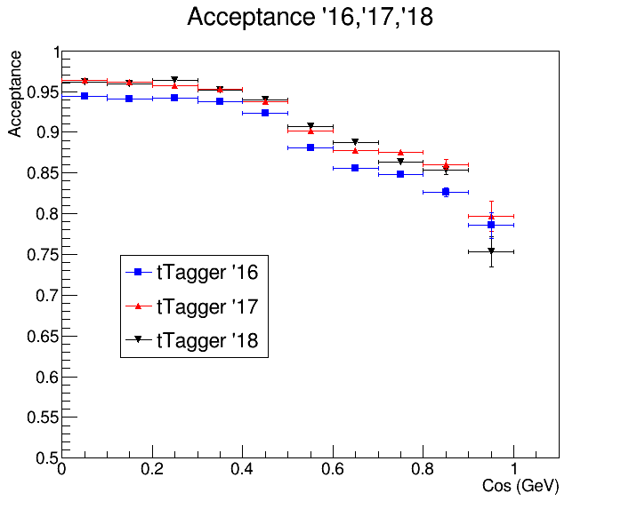


Efficiency and Acceptance for |cos(θ)| distribution 2016 vs 2017 vs 2018
$$|cos\left(θ^{∗}\right)|$$
$$|cos\left(θ^{∗}\right)|$$

Slide 26
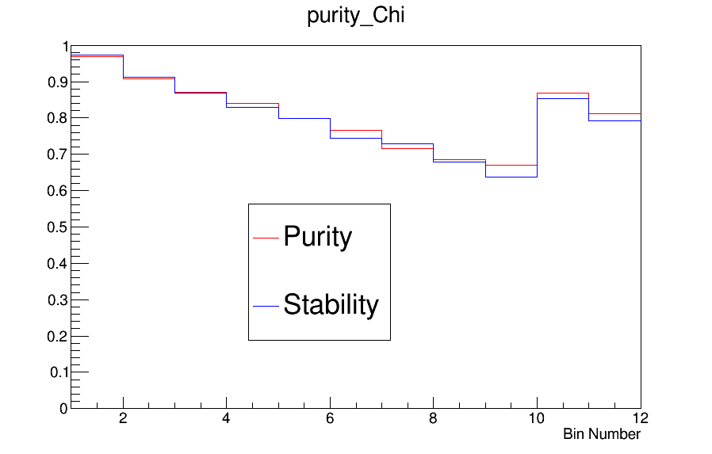
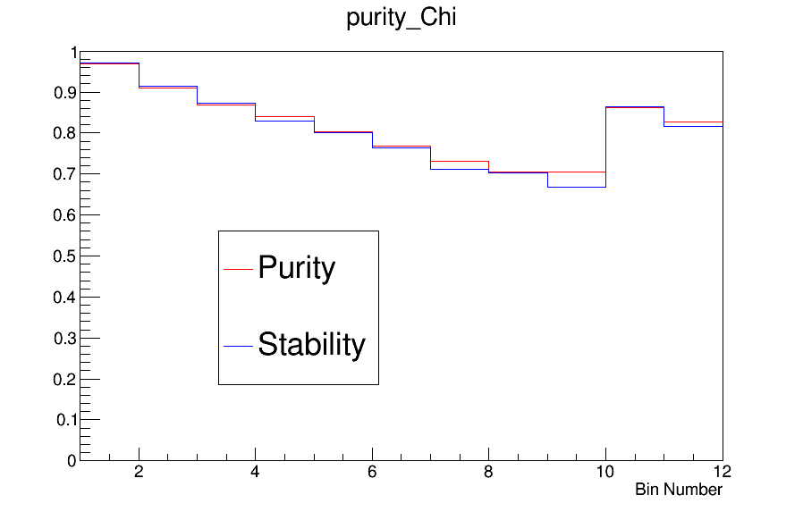
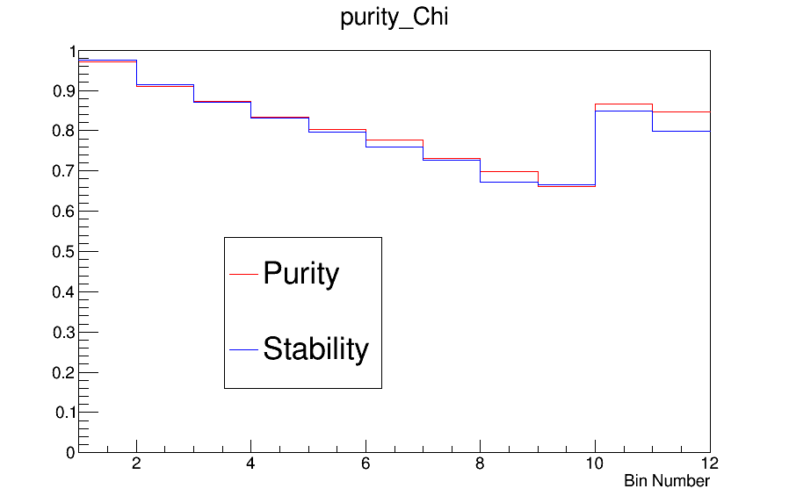
Purity and Stability for chi distribution
2016
2017
2018

Slide 27
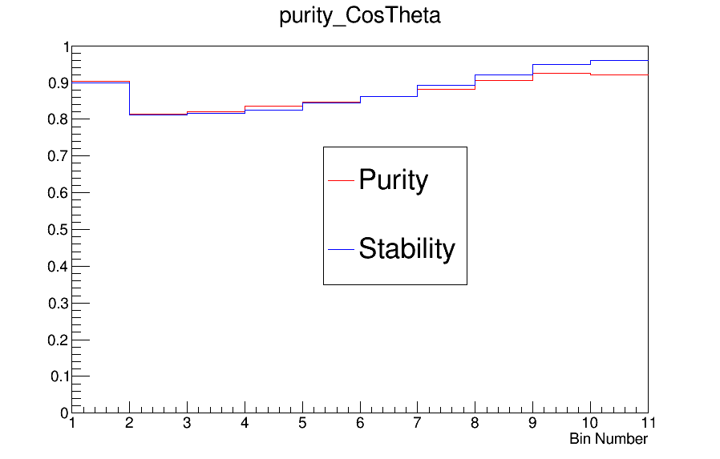
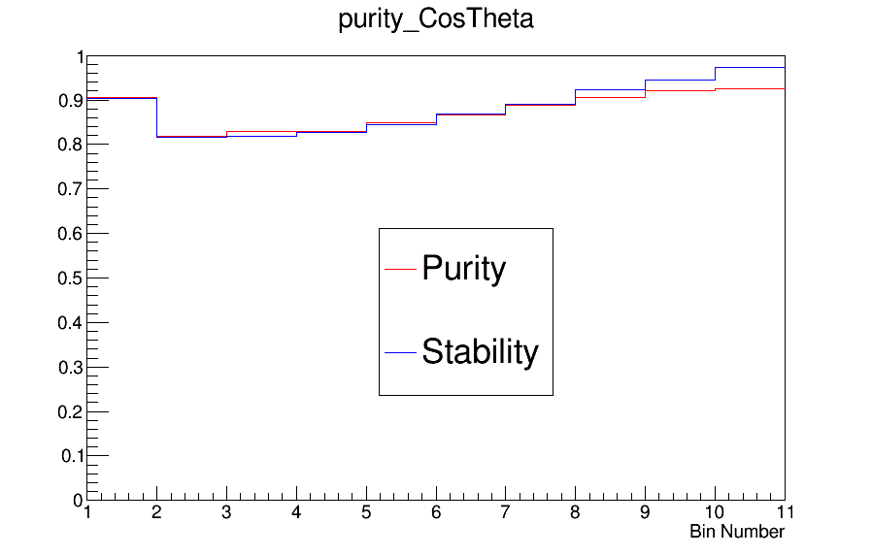
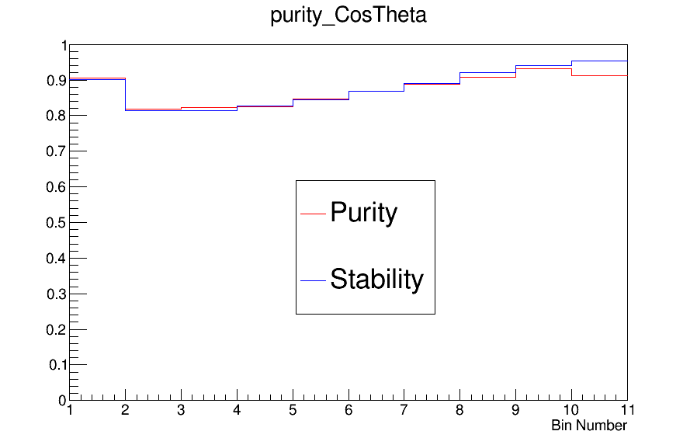
Purity and Stability for |cos(θ)| distribution
2016
2017
2018

Slide 28
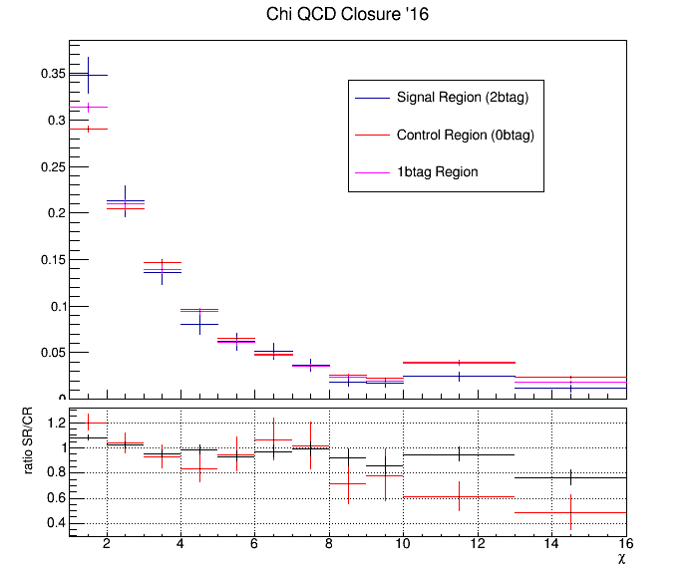
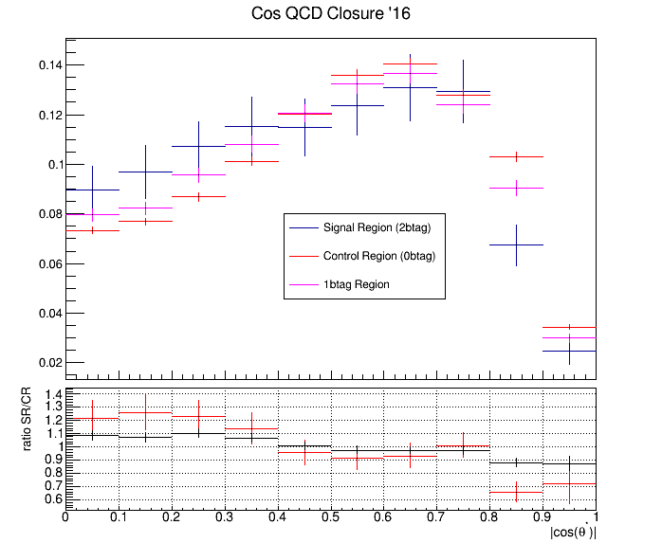
QCD Background MC closure tests 2016
Closure test for QCD samples in Control Region (SR but btagging is reverted (btag==0))

Slide 29
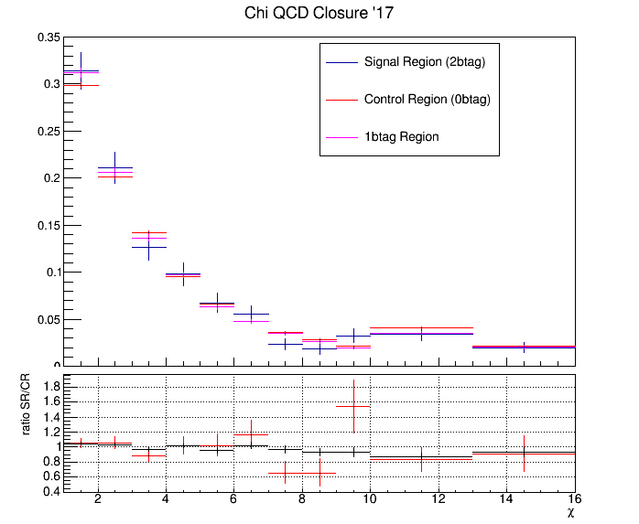
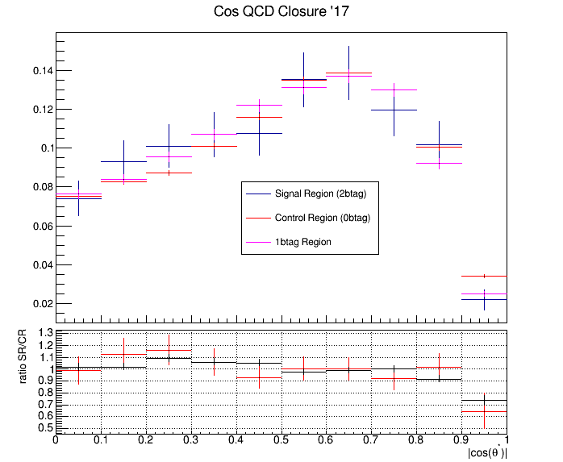
QCD Background MC closure tests 2017
Closure test for QCD samples in Control Region (SR but btagging is reverted (btag==0))

Slide 30
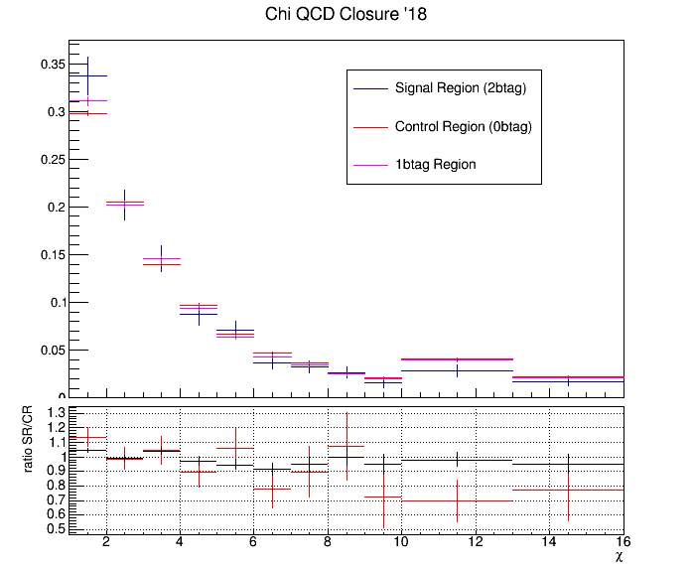
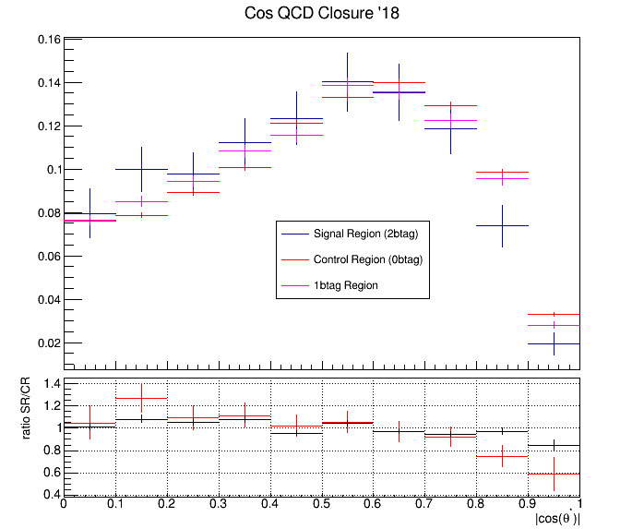
QCD Background MC closure tests 2018
Closure test for QCD samples in Control Region (SR but btagging is reverted (btag==0))

Slide 31
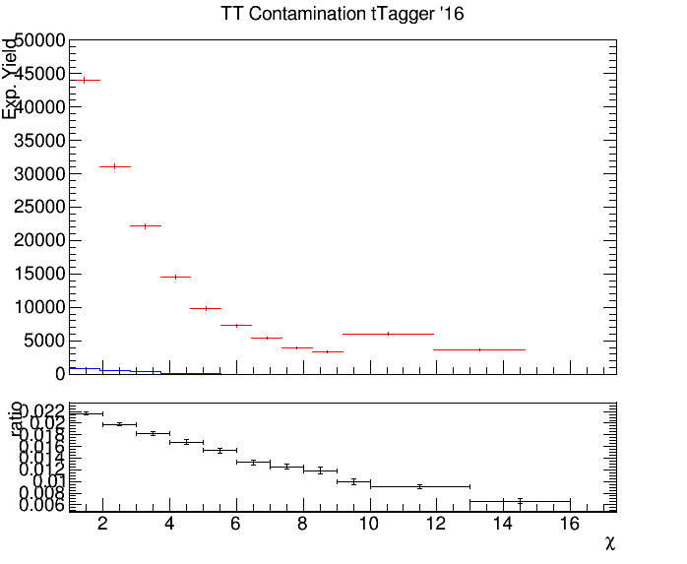
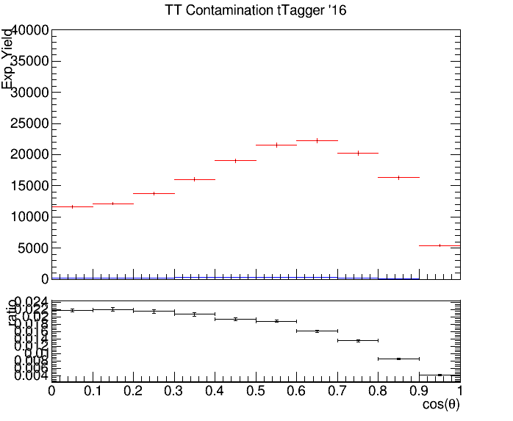

Control Region Contamination 2016
Expected yield from QCD Bkg samples and TT Signal sample in the CR
Control Region QCD sample
Control Region TT sample
Control Region QCD sample
Control Region TT sample
$$|cos\left(θ^{∗}\right)|$$

Slide 32
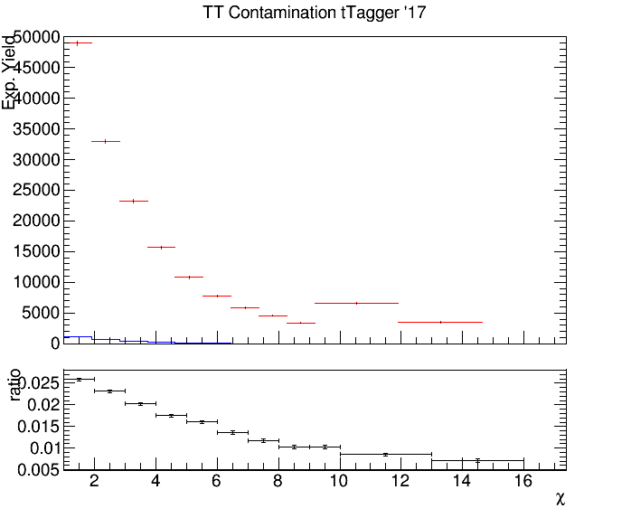
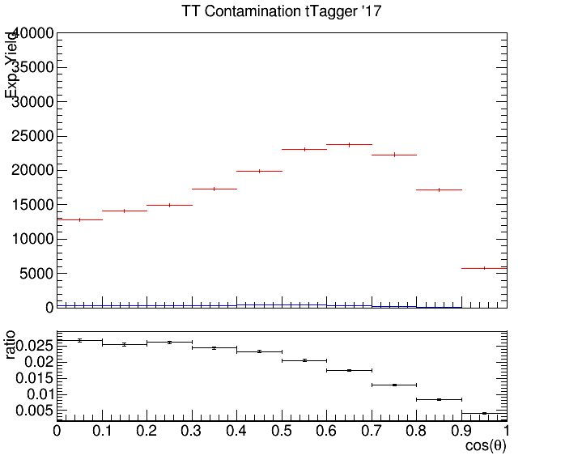

Control Region Contamination 2017
Expected yield from QCD Bkg samples and TT Signal sample in the CR
Control Region QCD sample
Control Region QCD sample
Control Region TT sample
Control Region TT sample
$$|cos\left(θ^{∗}\right)|$$

Slide 33
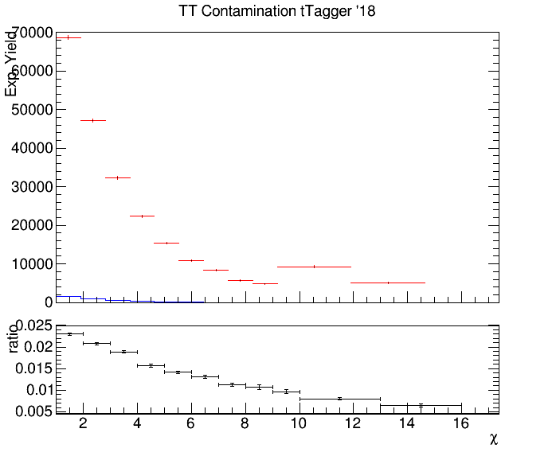
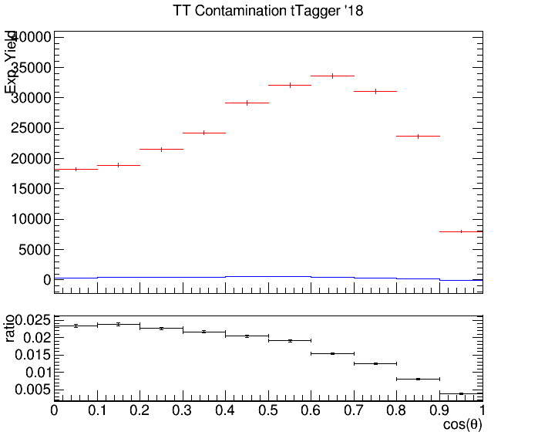

Control Region Contamination 2018
Expected yield from QCD Bkg samples and TT Signal sample in the CR
Control Region QCD sample
Control Region TT sample
Control Region QCD sample
Control Region TT sample
$$|cos\left(θ^{∗}\right)|$$

Slide 34
Top Spin Correlation
Files are ready (CMSSW 10_2X)
TT_noSC_Mtt-1000toInf_TuneCP5_13TeV-powheg-pythia8
TT_Mtt-1000toInf_TuneCP5_13TeV-powheg-pythia8
Chi2Test for various distributions
|Cos(χ₁)|, χ₁:angle between W’s in ZMF
|Cos(χ₂)|, χ₂:angle between top and W in ZMF
|Δφ| between W’s in parton level
What other distribution could have sensitivity to SC in the all hadronic channel?
If p_value < α (0.05) then we can assume that the hypothesis that the two histograms are identical is rejected
If p_value > α (0.05) then we can assume that the hypothesis that the two histograms are identical can be accepted
Chi2Test Results:
Chi2 = 143.020042, Prob = 2.53302e-16, NDF = 31, igood = 0
Chi2 = 38.513869, Prob = 0.166093, NDF = 31, igood = 0
Chi2 = 48.329603, Prob = 0.0135818, NDF = 29, igood = 0
$$|cos\left(θ^{∗}\right)|$$

Slide 35
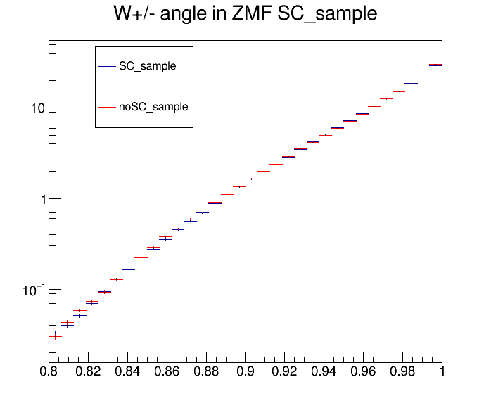

Top Spin Correlation
|cos(χ₁)|
|cos(χ₂)|

Slide 36

Top Spin Correlation
|Δφ|

